Slide 1
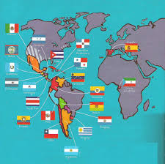
HISPANIC TERM

Slide 2
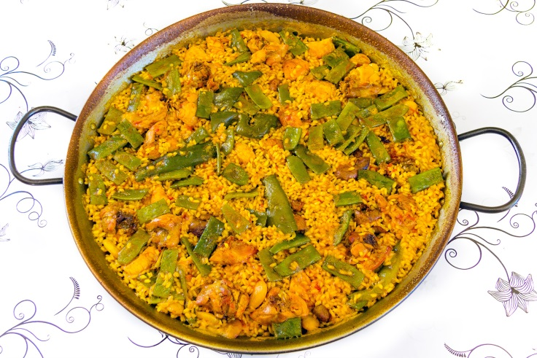
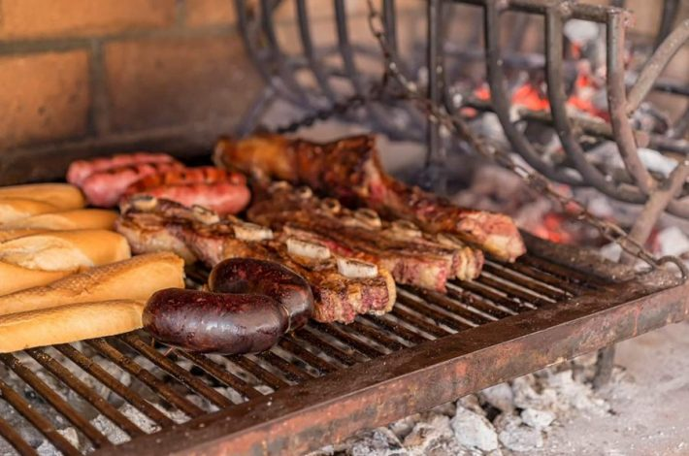
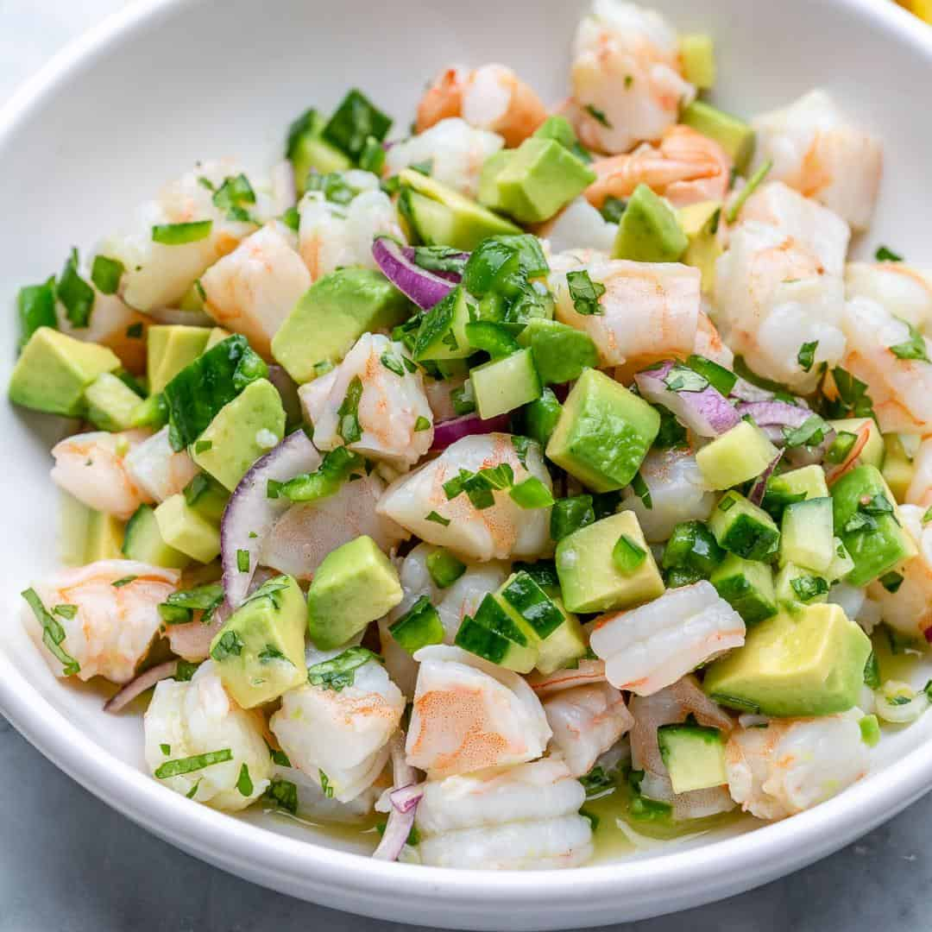
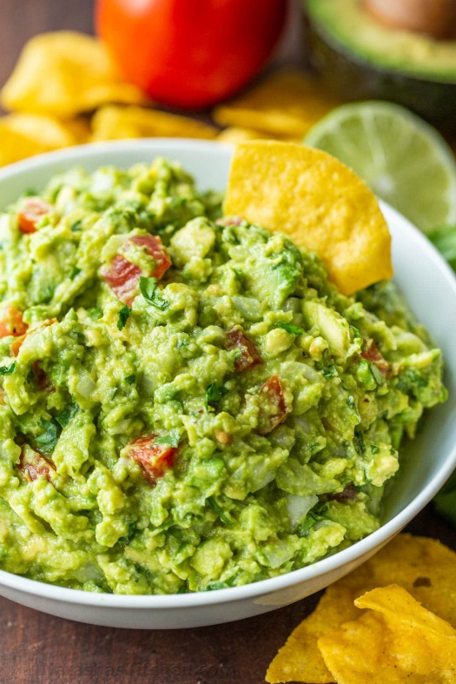
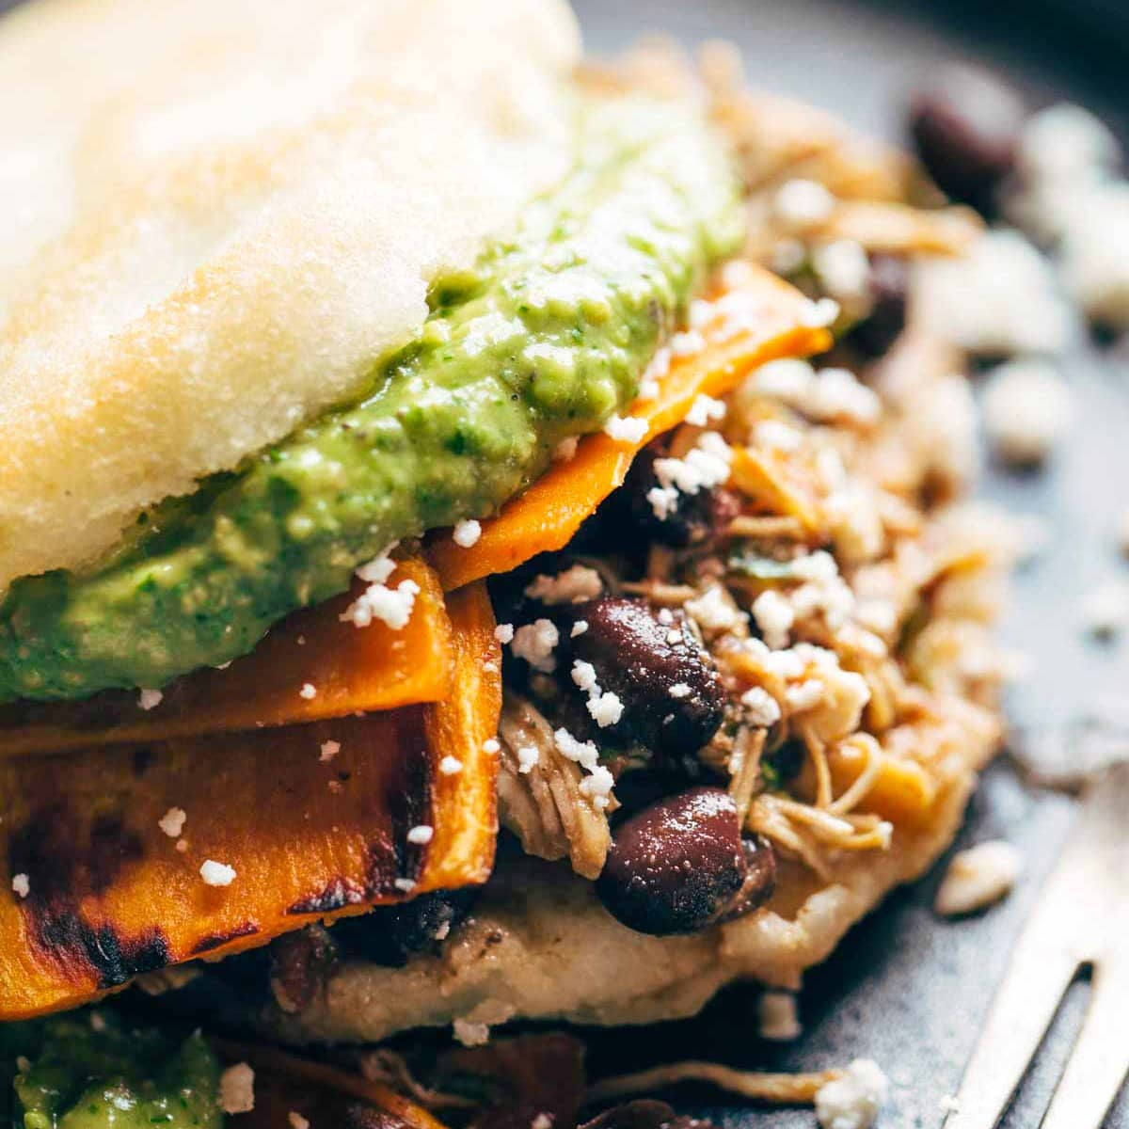
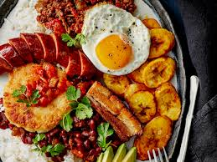
COMIDA
CEVICHE
PAELLA
AREPAS
GUACAMOLE
ASADO
BANDEJA PAISA

Slide 3
CAN YOU TELL WHAT COUNTRY ARE THOSE TRADITIONAL DISHES FROM? I GIVE YOU A CLUE IN THE NEXT SLIDE.
Can you name the ingredients that we use for those dishes in Spanish?
DO YOU KNOW ANY OTHER TRADITIONAL FOOD FROM SPANISH SPEAKING COUNTRIES?

Slide 4
COMIDA
PERÚ
ESPAñA
VENEZUELA
MÉXICO
ARGENTINA
COLOMBIA

Slide 5
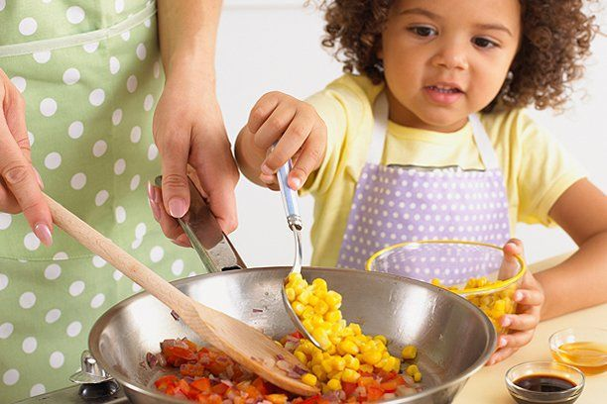
COOK A RECIPE

