Slide 1
Parent Information Session Year 1 Phonics
We will discuss:
The Phonics Screening Check
How Phonics is taught at St. Mary’s
How you can help at home
Notes:
Anna

Slide 2
Year 1 Phonics Screening Test
Week beginning 12th June 2017
Compulsory for all students in England
Shows how well your children can use their phonics skills and to identify students who need further help
Children are scored against a national standard. The main result is whether they fall above or below this standard
Children who do not meet the required standard have the opportunity to retake the test in Year 2
Notes:
Anna

Slide 3
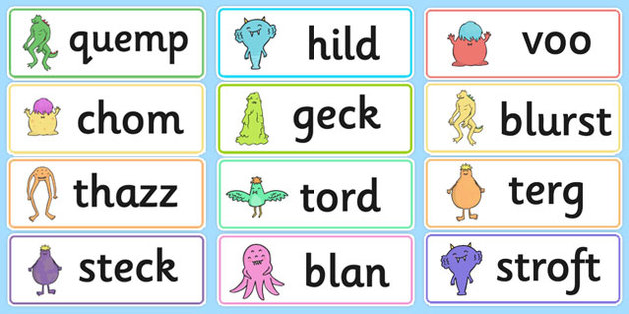
The Test
40 words and non- words (we call these alien or nonsense words) that match what we’ve been learning in phonics
Focus is on children blending accurately when reading words
Children read one on one with teacher
Nonsense or alien words have a picture of a monster next to them (we use this in class too)
Notes:
Anna

Slide 4
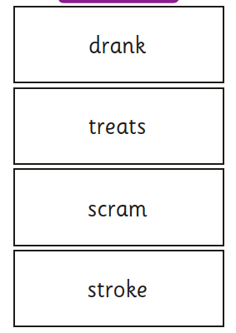
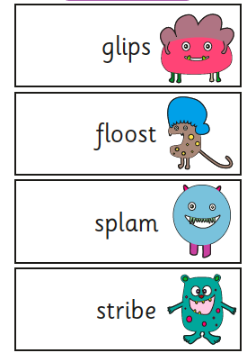
Example
Notes:
Anna

Slide 5
Phonics
Awareness of sounds in spoken words (foundation- should have been attained in Nursery and Reception)
Link between sounds and letters
Reading: recognising letters by giving them a sound and then blending the sound to pronounce the word
Spelling: segmenting words into individual sounds using letters to represent sounds
The Phonics Screening Check is concerned with reading only
Notes:
Jess

Slide 6
Daily Phonics at School
Every day the children have 30 minutes in groups
Fast paced approach (one sound per day)
We use the Letters and Sounds phonics program
There are 6 phonics phases which the children work through at their own pace. The groups are organised into these phases.
Notes:
Jess

Slide 7
Phonics Terms
Terms your children learn at school:
Phonemes: The smallest units of sound that are found within a word (e.g. c a t ch i p)
. . . _ . .
Grapheme: The spelling of the sound e.g. th
Diagraph: Two letters that make one sound when read sh ng
Trigraphs: Three letters that make one sound igh
CVC: Stands for consonant, vowel, consonant pin sit web
Segmenting is breaking up a word into its sounds.
Blending : Putting the sounds together to read a word
Notes:
Jess

Slide 8
Saying the sounds
Sounds should be articulated clearly and precisely.
Be careful an ‘uh’ sound is not added to the end of sounds
Be aware of bad pronunciations that can be found online (YouTube etc.)
Useful link: https://www.youtube.com/watch?v=BqhXUW_v-1s
Notes:
Jess

Slide 9
Blending
Children need to be able to hear the separate sounds in a word and then blend them together to say the whole word.
/b/ /e/ /d/ = bed
/t/ /i/ /n/ = tin
/m/ /u/ /g/ = mug
Notes:
Jess

Slide 10
Segmenting
Children need to be able to hear a whole word and say every sound that they hear.
bed = /b/ /e/ /d/
tin= /t/ /i/ /n/
mug= /m/ /u/ /g/
Notes:
Jess

Slide 11
Helping at Home
Practice the words sent home in the Homework Books and follow any instructions written in blue. This is important even if your child spelt all of the words correctly
Ask your child to practice the Phase 3 and 5 sounds using their sound mat regularly
Reading: Ask your children to segment the words and then blend them to help them to read the words
Writing: Give your children words from their spelling test to spell and ask them to segment them and then blend them. Also, ask them to put them into sentences
Notes:
Jess

Slide 12
Any questions?

